Slide 1
Particle Swarm Simulation
Robert Rajakone
Roger Müller
Florian Bruggisser

Slide 2
Basic Swarm Simulation
Basic flocking algorithm based on Craig Reynolds
Cohesion
Alignment
Separation
Visualize in 3d space
Notes:
First step of our project -> build basis

Slide 3
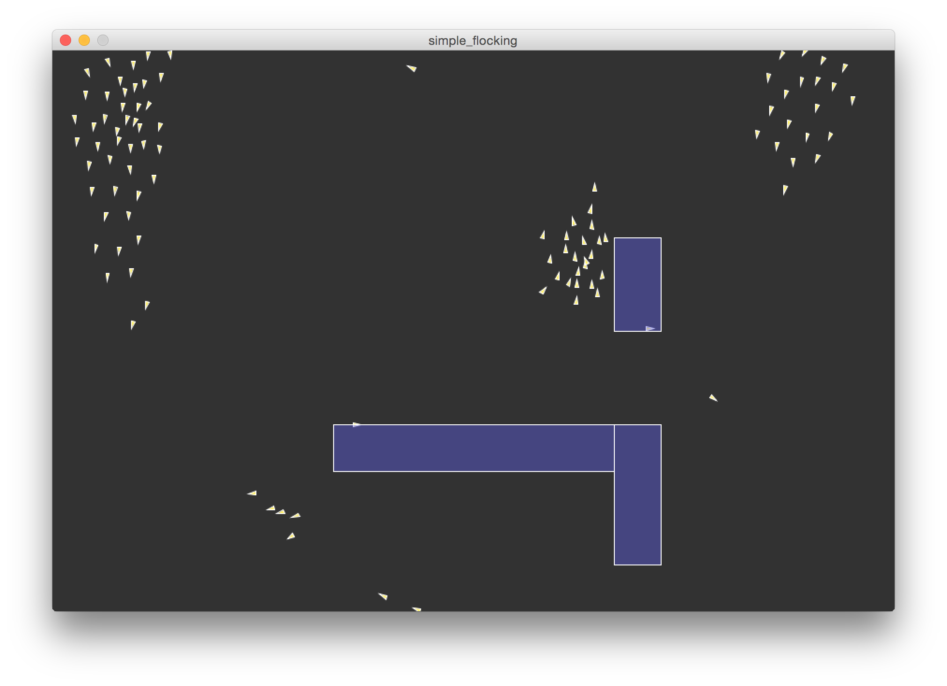
Flocking Demo

Slide 4
Enhanced Swarm Simulation
Alignment on different figures (2d / 3d)
Alignment on drawings by the user
Object detection
Path finding
Other ideas
Design
Notes:
Second step of the project -> implement interesting ideas and workflows

Slide 5
Example

Slide 6
Editor
Edit parameters
Create new particles
Create new objects
Draw own alignment graphics
Steer Boids

Slide 8
Questions?

